Slide 1
Programming Logic and Design Ninth Edition
Chapter 4
Making Decisions

Slide 2
Objectives
In this chapter, you will learn about:
The selection structure
The relational comparison operators
AND logic
OR logic
NOT logic
Making selections within ranges
Precedence when combining AND and OR operators
The case structure

Slide 3
The Selection Structure
Boolean expressions can be only true or false
Every computer decision yields a true-or-false, yes-or-no, 1-or-0 result
Used in every selection structure

Slide 4
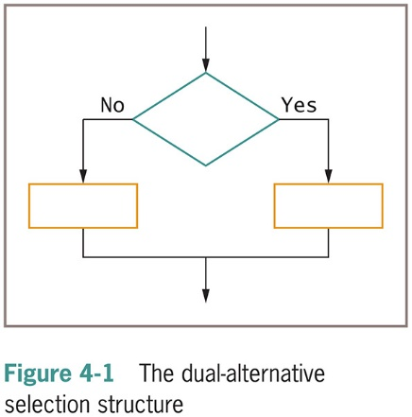
The Selection Structure (continued -1)
Dual-alternative (or binary) selection structure
Provides an action for each of two possible outcomes

Slide 5
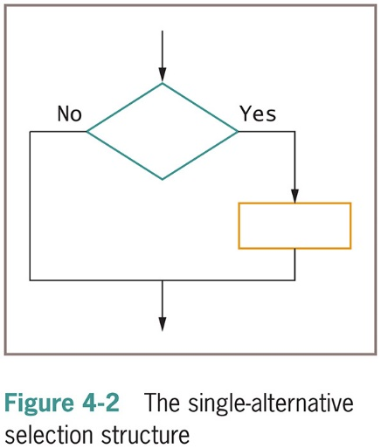
The Selection Structure (continued -2)
Single-alternative (or unary) selection structure
Action is provided for only one outcome

Slide 6
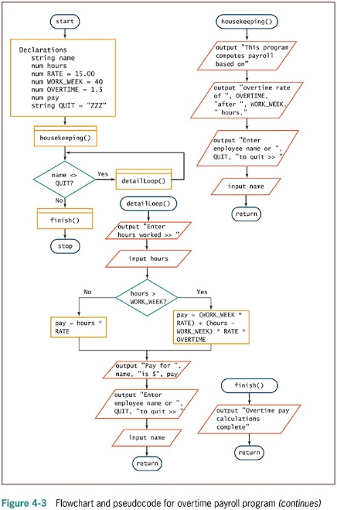
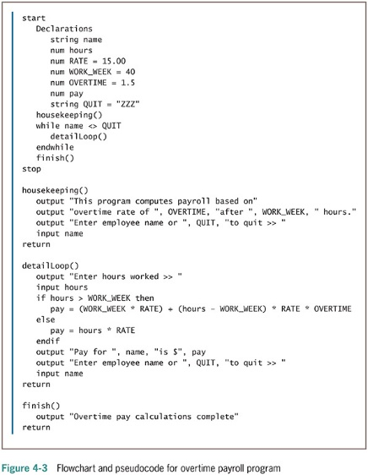
The Selection Structure (continued -3)

Slide 7
The Selection Structure (continued -4)
if-then-else decision
if-then clause
Holds the action or actions that execute when the tested condition in the decision is true
else clause
Executes only when the tested condition in the decision is false

Slide 8
Using Relational Comparison Operators
Relational comparison operators
Six types supported by all modern programming languages
Two values compared can be either variables or constants but must be same data type
Trivial expressions
Will always evaluate to the same result
Examples:
20 = 20? TRUE
30 = 40? FALSE

Slide 9
Using Relational Comparison Operators (continued -1)
Relational comparison operators
Equivalency operator: =
Evaluates as true when its operands are equivalent
Greater-than operator: >
Evaluates as true when the left operand is greater than the right operand
Less-than operator: <
Evaluates as true when the left operand is less than the right operand

Slide 10
Using Relational Comparison Operators (continued -2)
Relational comparison operators
Greater-than–or-equal-to operator: >=
Evaluates as true when the left operand is greater than or equivalent to the right operand
Less-than–or-equal-to operator: <=
Evaluates as true when the left operand is less than or equivalent to the right operand
Not-equal-to operator: <>
Evaluates as true when its operands are not equivalent

Slide 11
Using Relational Comparison Operators (continued -3)
Any decision can be made with only three types of comparisons: =, >, and <
“Not equal” operator <>
Involves thinking in double negatives
Best to restrict usage to “if without an else”—that is, only take action when some comparison is false

Slide 12
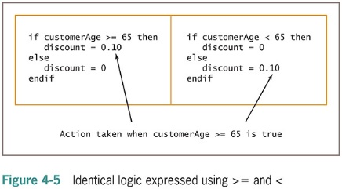
Using Relational Comparison Operators (continued -4)

Slide 13
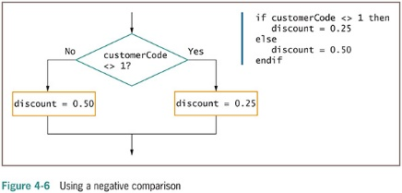
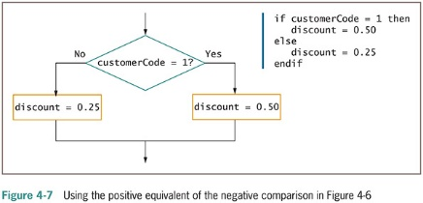
Using Relational Comparison Operators (continued -5)

Slide 14
Avoiding a Common Error with Relational Operators
Common errors
Using the wrong operator
BIG > small
small < BIG
Missing the boundary or limit required for a selection

Slide 15
Understanding AND Logic
Compound condition
Asks multiple questions before an outcome is determined
AND decision
Requires that both of two tests evaluate to true
Requires a nested decision (nested if) or a cascading if statement

Slide 16
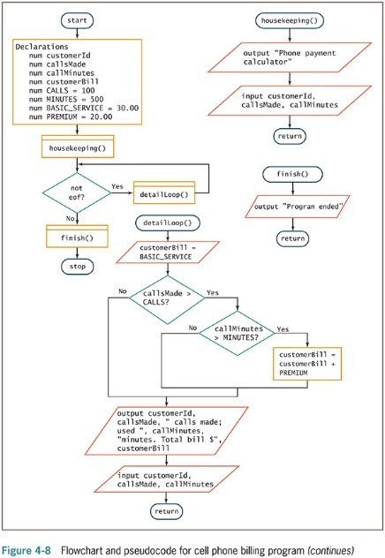
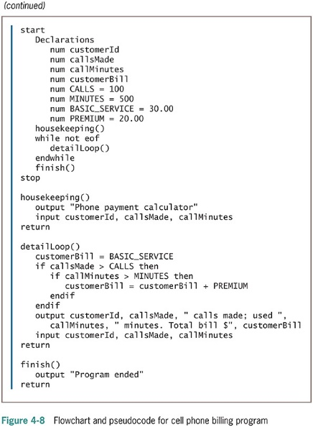
Understanding AND Logic (continued -1)

Slide 17
Nesting AND Decisions for Efficiency
When nesting decisions
Either selection can come first
Performance time can be improved by asking questions in the proper order
In an AND decision, first ask the question that is less likely to be true
Eliminates as many instances of the second decision as possible
Speeds up processing time

Slide 18
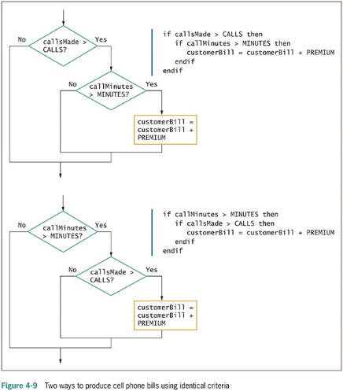
Nesting AND Decisions for Efficiency (continued -1)

Slide 19
Using the AND Operator
Conditional AND operator (simply an AND operator)
Ask two or more questions in a single comparison
Each Boolean expression must be true for entire expression to evaluate to true
Truth tables
Describe the truth of an entire expression based on the truth of its parts
Short-circuit evaluation
Expression evaluated only as far as necessary to determine truth

Slide 20
Using the AND Operator (continued -1)
Combine several Boolean expressions that have true/false meaning into a single expression using the AND operator
In an AND operation both expressions must be true in order for the entire expression itself to be true
Example:
If I want to go to the movie AND I have enough money then I will go to the movie.

Slide 21
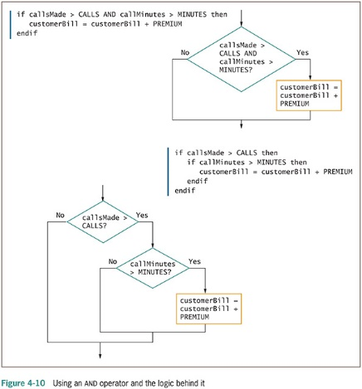
Using the AND Operator (continued -2)

Slide 22
Avoiding Common Errors in an AND Selection
Second decision must be made entirely within the first decision
In most programming languages, logical AND is a binary operator
Requires a complete Boolean expression on both sides
Expressions should not be trivial

Slide 23
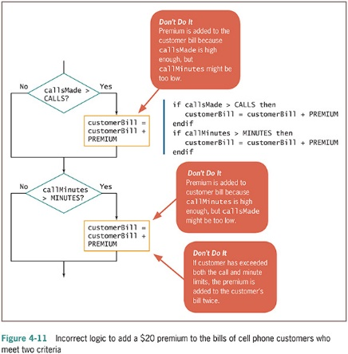
Avoiding Common Errors in an AND Selection (continued -1)

Slide 24
Understanding OR Logic
OR decision
Take action when one or the other of two conditions is true
Example
“Are you free for dinner Friday or Saturday?”

Slide 25
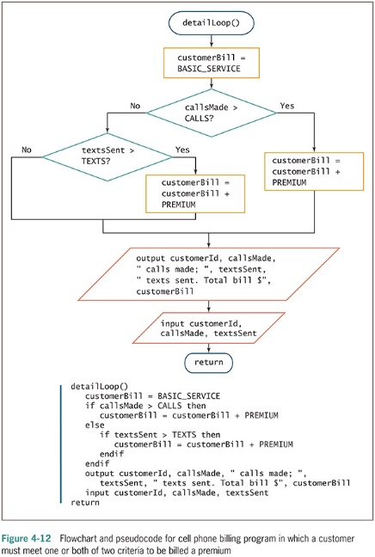
Understanding OR Logic (continued -1)

Slide 26
Writing OR Selections for Efficiency
May ask either question first
Both produce the same output but vary widely in number of questions asked
If first question is true, no need to ask second
In an OR decision, first ask the question that is more likely to be true
Eliminate as many extra decisions as possible

Slide 27
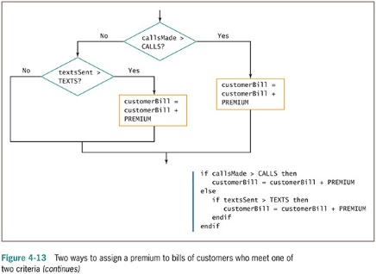
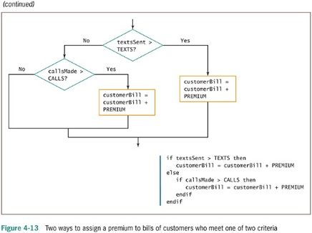
Writing OR Selections for Efficiency (continued -1)

Slide 28
Using the OR Operator
Conditional OR operator (simply an OR operator)
Ask two or more questions in a single comparison
Only one Boolean expression in an OR selection must be true to produce a result of true
Question placed first will be asked first
Consider efficiency
Computer can ask only one question at a time

Slide 29
Avoiding Common Errors in an OR Selection
Second question must be a self-contained structure with one entry and exit point
Request for A and B in English logically means a request for A or B
Examples
“Add $20 to the bill of anyone who makes more than 100 calls and to anyone who has used more than 500 minutes”
“Add $20 to the bill of anyone who has made more than 100 calls or has used more than 500 minutes”

Slide 30
Avoiding Common Errors in an OR Selection (continued -1)
Make sure Boolean expression are complete
Make sure that selections are structured
Make sure to use OR selections when they are required
Make sure that expression are not trivial

Slide 31
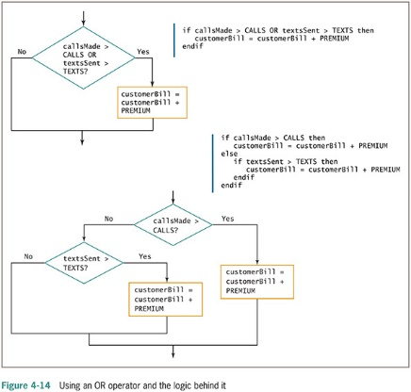
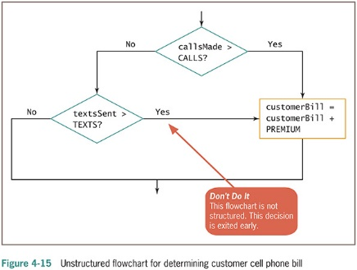
Avoiding Common Errors in an OR Selection (continued -2)

Slide 32
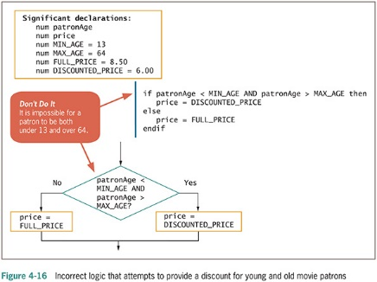
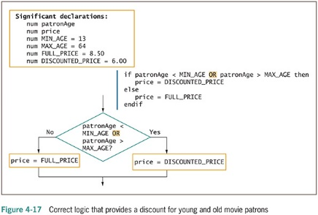
Avoiding Common Errors in an OR Selection (continued -3)

Slide 33
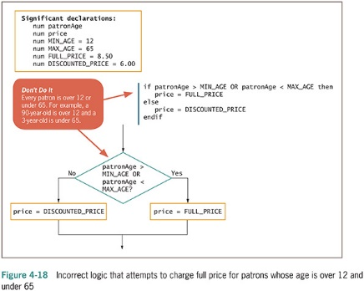
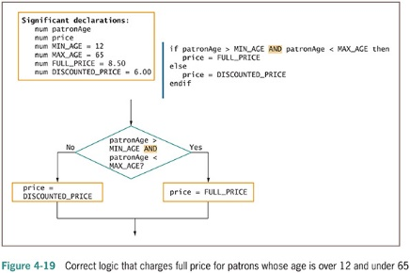
Avoiding Common Errors in an OR Selection (continued -4)

Slide 34
Understanding NOT Logic
The NOT operator
Reverses the meaning of a Boolean expression
if NOT (age < 18) then
output "Can register to vote"
Endif
If NOT true, it is false
If NOT false, it is true
Is a unary operator
Takes only one operator

Slide 35
Avoiding a Common Error in a NOT Expression
Be careful not to create trivial expressions
Incorrect code:
if NOT (employeeDept = 1) OR NOT (employeeDept = 2) then
output "Employee is not in Department 1 or 2“
Endif
Correct code: if NOT (employeeDept = 1 OR employeeDept = 2) then
output "Employee is not in Department 1 or 2"
endif

Slide 36
Making Selections Within Ranges
Range check
Compare a variable to a series of values between limits
Use the lowest or highest value in each range
Adjust the question logic when using highest versus lowest values
Should end points of the range be included?
Yes: use >= or <=
No: use < or >

Slide 37
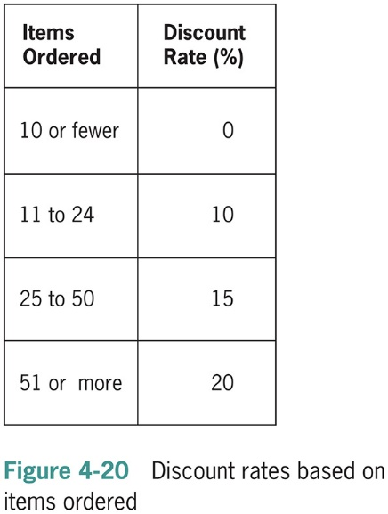
Making Selections Within Ranges (continued -1)

Slide 38
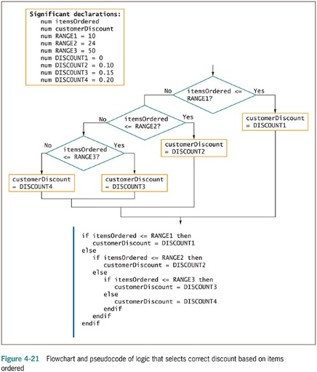
Making Selections Within Ranges (continued -2)

Slide 39
Avoiding Common Errors When Using Range Checks
Avoid a dead or unreachable path
Don’t check for values that can never occur
Requires some prior knowledge of the data
Never ask a question if there is only one possible outcome
Avoid testing the same range limit multiple times

Slide 40
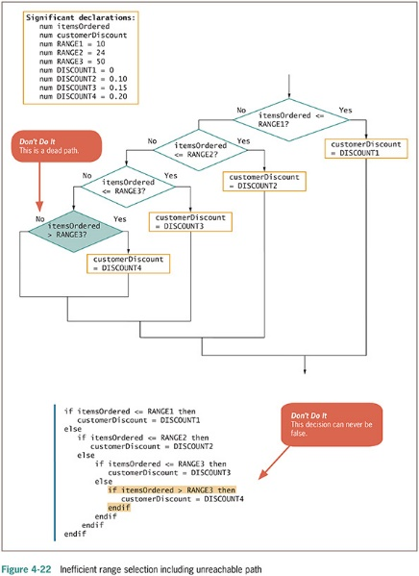
Eliminating Dead Paths

Slide 41
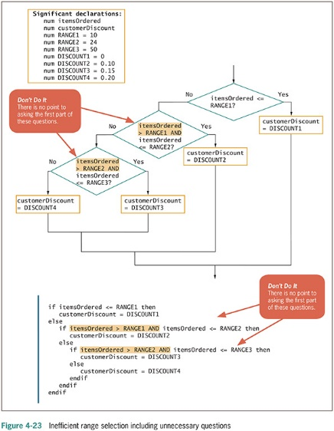
Avoid Testing the Same Range Limit Multiple Times

Slide 42
Understanding Precedence When Combining AND and OR Operators
Combine multiple AND and OR operators in an expression
When multiple conditions must all be true, use multiple ANDs
if score1 >= MIN_SCORE AND score2 >= MIN_SCORE AND score 3 >= MIN_SCORE then
classGrade = "Pass"
else
classGrade = "Fail"
endif

Slide 43
Understanding Precedence When Combining AND and OR Operators (continued -1)
When only one of multiple conditions must be true, use multiple ORs
if score1 >= MIN_SCORE OR score2 >= MIN_SCORE OR score3 >= MIN_SCORE then
classGrade = "Pass"
else
classGrade = "Fail"
endif

Slide 44
Understanding Precedence When Combining AND and OR Operators (continued -2)
When AND and OR operators are combined in the same statement, AND operators are evaluated first
if age <= 12 OR age >= 65 AND rating = "G"
Use parentheses to correct logic and force evaluations to occur in the order desired
if (age <= 12 OR age >= 65) AND rating = "G"

Slide 45
Understanding Precedence When Combining AND and OR Operators (continued -3)
Mixing AND and OR operators makes logic more complicated
Can avoid mixing AND and OR decisions by nesting if statements

Slide 46
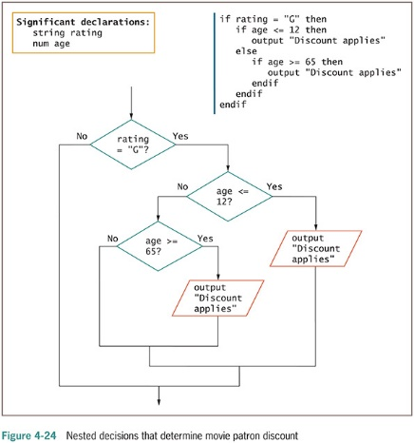
Understanding Precedence When Combining AND and OR Operators (continued -4)

Slide 47
Understanding the case Structure
Case structure – specialized selection structure
Use when there are several distinct possible values for a single variable
And each value requires a different subsequent action

Slide 48
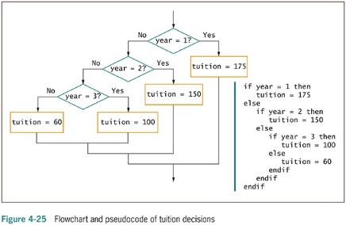
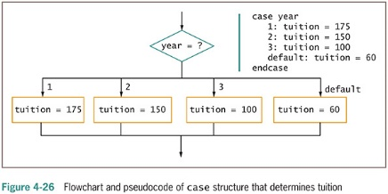
Understanding the case Structure (continued -1)

Slide 49
Summary
Decisions involve evaluating Boolean expressions
Use relational operators to compare values
An AND decision requires that both conditions be true to produce a true result
In an AND decision, first ask the question that is less likely to be true
An OR decision requires that either of the conditions be true to produce a true result
In an OR decision, first ask the question that is more likely to be true

Slide 50
Summary (continued -1)
For a range check:
Make comparisons with the highest or lowest values in each range
Eliminate unnecessary or previously answered questions
The AND operator takes precedence over the OR operator
Case structure is a specialized selection structure that can be used when there are several distinct possible values for a single variable, and each value requires a different subsequent action

